Slide 1
E-MEDICARE
PROJECT MEMBERS
1. Adesh Maheshkumar Chavan
2. Akkinpally Ajay
3. Arimanda Rushitha
4. Kommala Joy Benjamin
5. Mahanandigari Chayadevi
6. Ankush Kailash Pardeshi
7. Bhuvaneshwari P
8. Shweta X
9. Suhaas Kamath
10. Kavya Shanmugam
11. Rangineni Sowmya

Slide 2
ABSTRACT
The purpose of E-Medicare System is to automate the existing manual system by the help of computerized equipment's and full-fledged computer software, fulfilling their requirements, so that their valuable data/information can be stored for a longer period with easy accessing and manipulation of the same.
E-Medicare System, as described above, can lead to error free, secure, reliable and fast management system.
The aim is to automate its existing manual system by the help of computerized equipment's and full-fledged computer software, fulfilling their requirements, so that their valuable data/information can be stored for a longer period with easy accessing and manipulation of the same.

Slide 3
INTRODUCTION
The “Online Medical Store” has been developed to override the problems prevailing in the practicing manual system. This software is supposed to eliminate and reduce the hardships faced by the existing system. Online Medical Store can lead to error free, secure, reliable and fast management system.
"Online Medical Store" - web application [J2EE Batches - Web Application], where users can register, login, purchase medicines e.g. Antibiotics, Antipyretics. and manage their orders in the system.

Slide 4
PROPOSED SYSTEM
The proposed medical Booking Store system will completely Revolutionize the industry.
Searching of products, order placing, billing and product stock can be maintained by a single click.
The order placed can be easily tracked At any time. The payment of the order can also be done by credit cards.

Slide 5
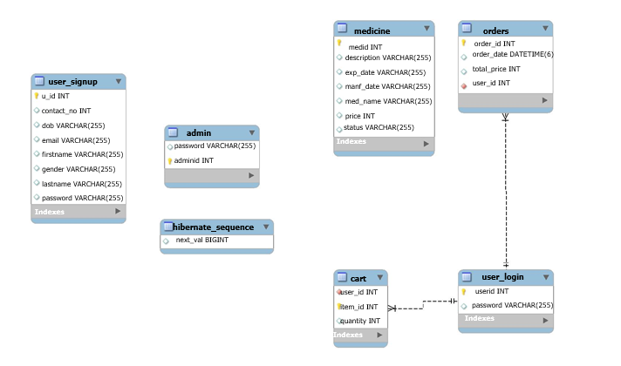
ER-DIAGRAM

Slide 6
TECHNOLOGY USED
HTML : Page layout has been designed in HTML
CSS : CSS has been used for all the designing part
JavaScript : All the validation task and animations has been developed by JavaScript
JSP : All the front end logic has been written in JSP
Java : All the business logic has been written in Java
MySQL : MySQL database has been used as database for the project
Angular CLI : Command-line interface tool that we use to initialize.

Slide 7
ENVIRONMENT
The system will be developed on any Windows OS machine using J2EE, Hibernate and Spring.
Intel hardware machine (PC P4-2.26 GHz, 512 MB RAM, 40 GB HDD)
Server – Apache Tomcat 8
Database – My SQL
My SQL J Connector
Node Version 10
Angular CLI
JDK 1.8
Eclipse IDE or Spring Tool Suite

Slide 8
MODULES OF E-MEDICARE SYSTEM
Customer Module: Used for managing the Customer details.
Order Module: Used for managing the details of Order
Payment Module: Used for managing the details of Payment
Medicine Module: Used for managing the Medicine details
Login Module: Used for managing the login details
Users Module: Used for managing the users of the system.
Admin Module: Used for managing medicine details and user information.

Slide 9
UML DIAGRAMS
UML, short for Unified Modeling Language
It is a standardized modeling language consisting of an integrated set of diagrams, developed to help system and software developers for specifying, visualizing, constructing, and documenting the artifacts of software systems, as well as for business modeling and other non-software systems.
The UML is a very important part of developing object oriented software and the software development process.
The UML uses mostly graphical notations to express the design of software projects.

Slide 10
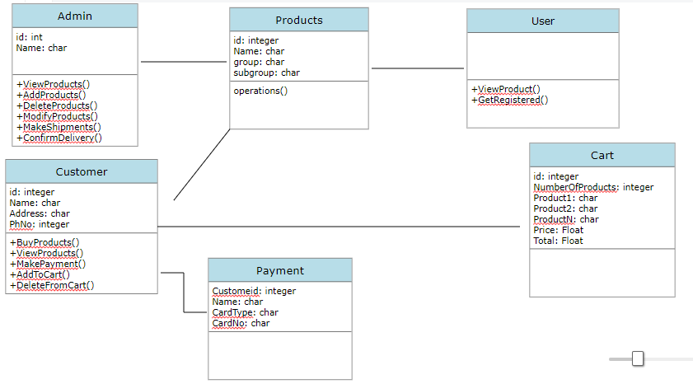
CLASS DIAGRAM

Slide 11
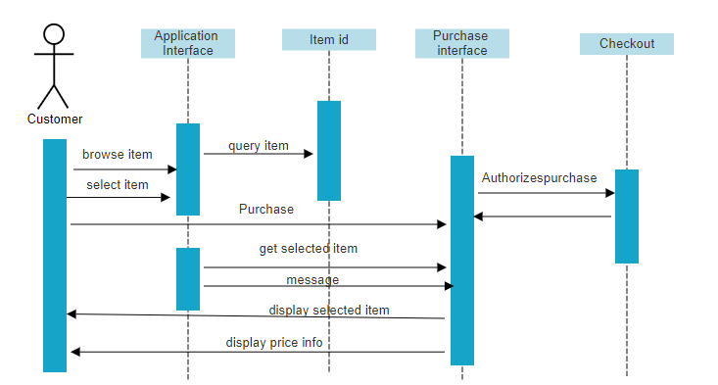
SEQUENCE DIAGRAM

Slide 12
ADVANTAGES
User can view details of the medicines without going anywhere.
It is convenient for users as this system provides accurate cost and description of the system.
The website is flexible to be used and for e-shopping.
User can view different categories of product of different pharma company at a single place.

Slide 13
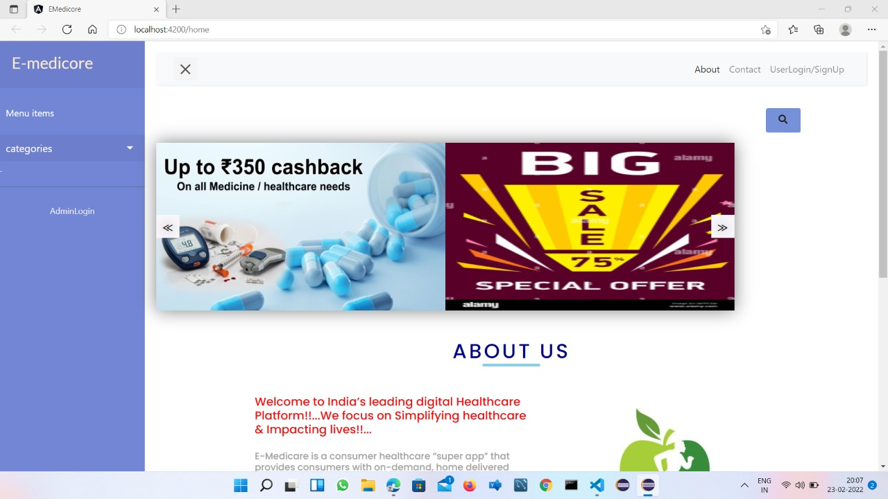
OUTPUT SCREENSHOTS
HOME PAGE

Slide 14
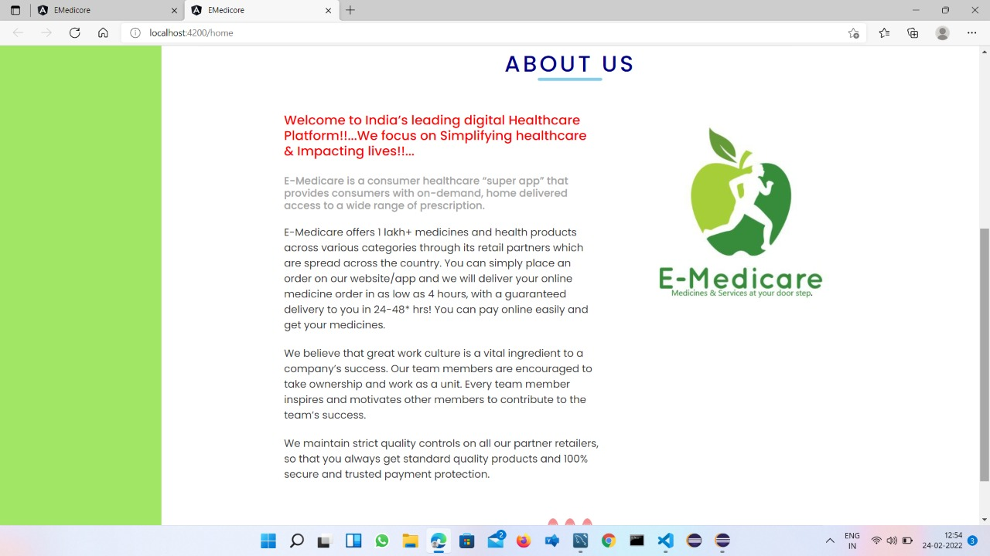
ABOUT US PAGE

Slide 15
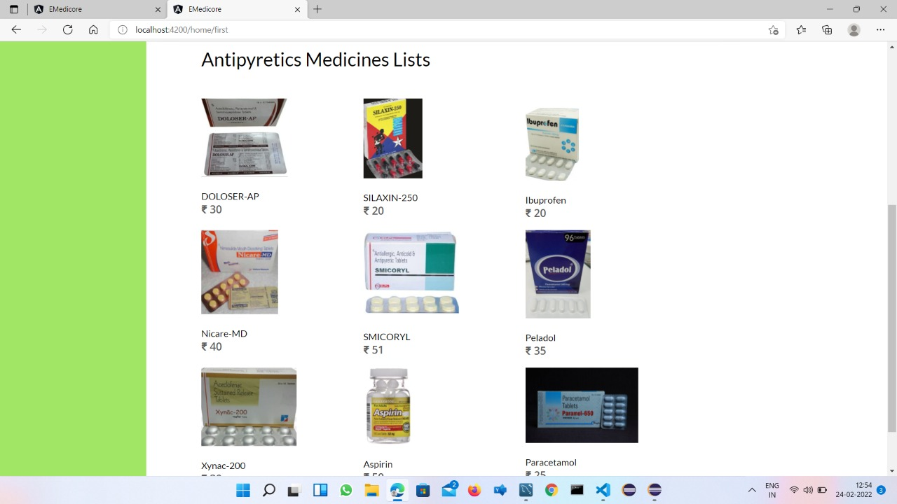
ANTIPYRETICS CATEGORY PAGE

Slide 16
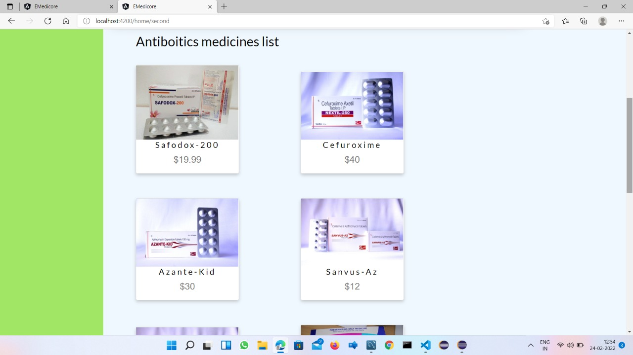
ANTIBIOTICS CATEGORY PAGE

Slide 17
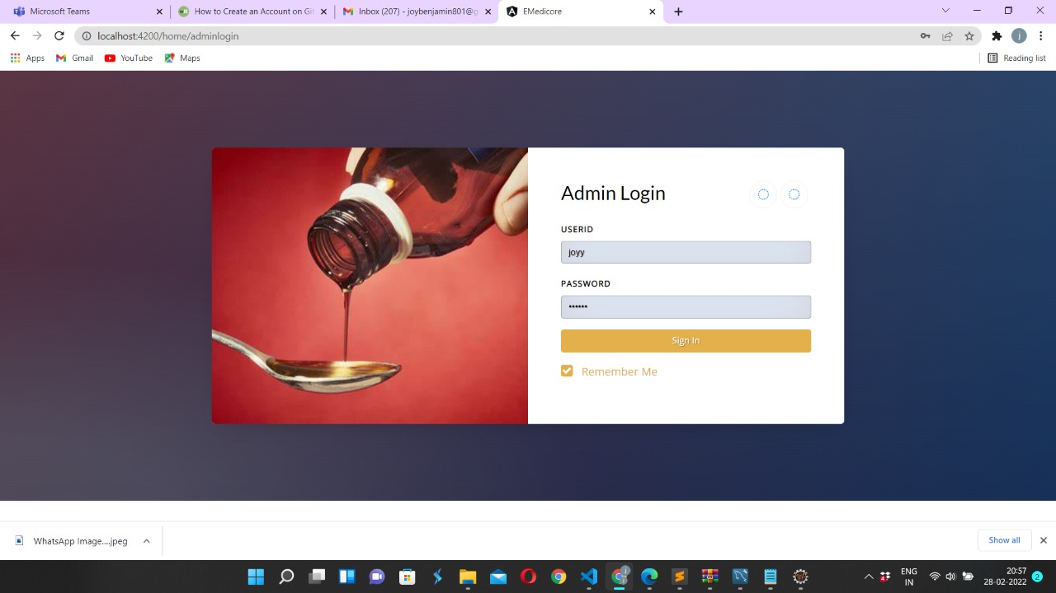
ADMIN LOGIN PAGE

Slide 18
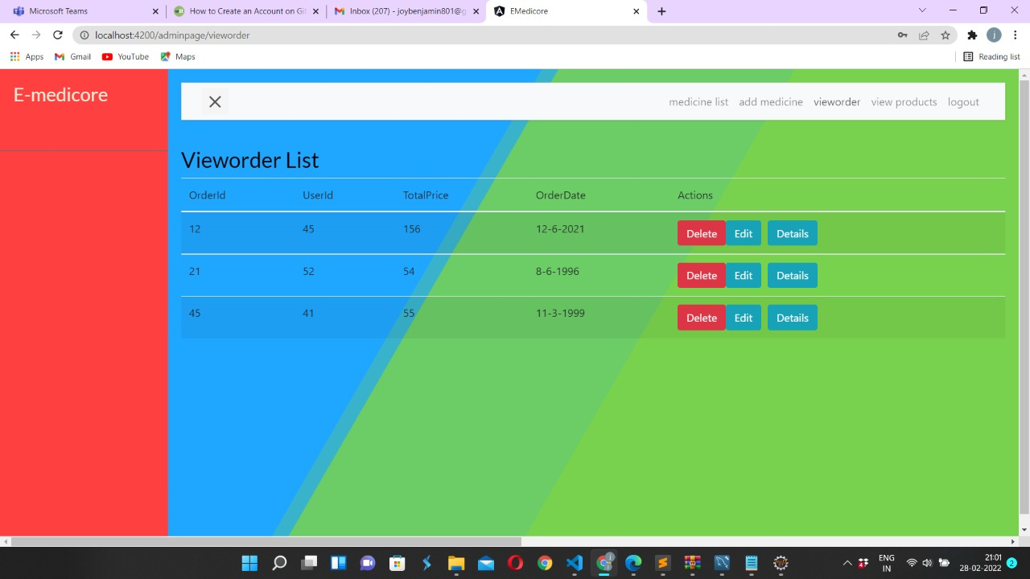
VIEW ORDER LIST PAGE

Slide 19
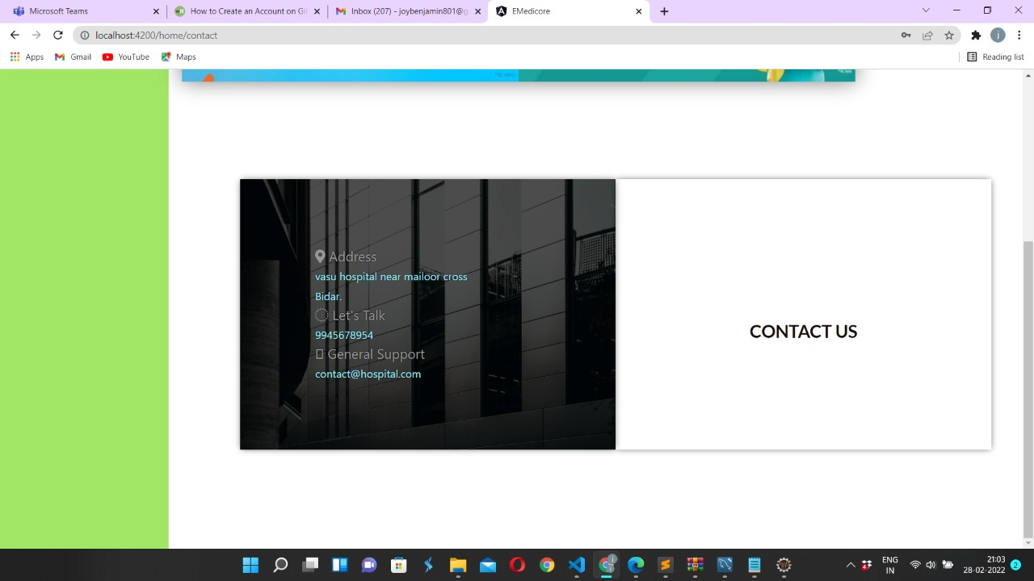
CONTACT US PAGE

Slide 20
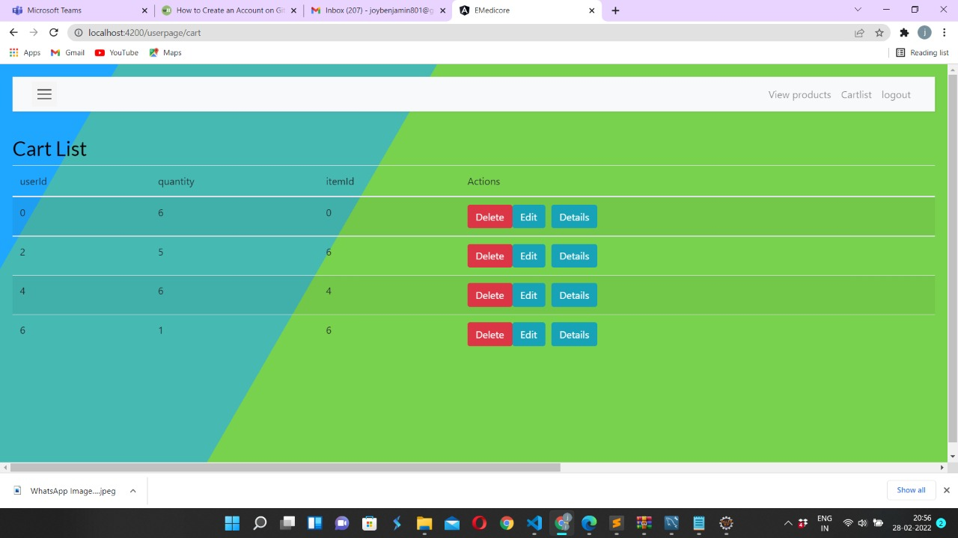
CART LIST PAGE

Slide 21
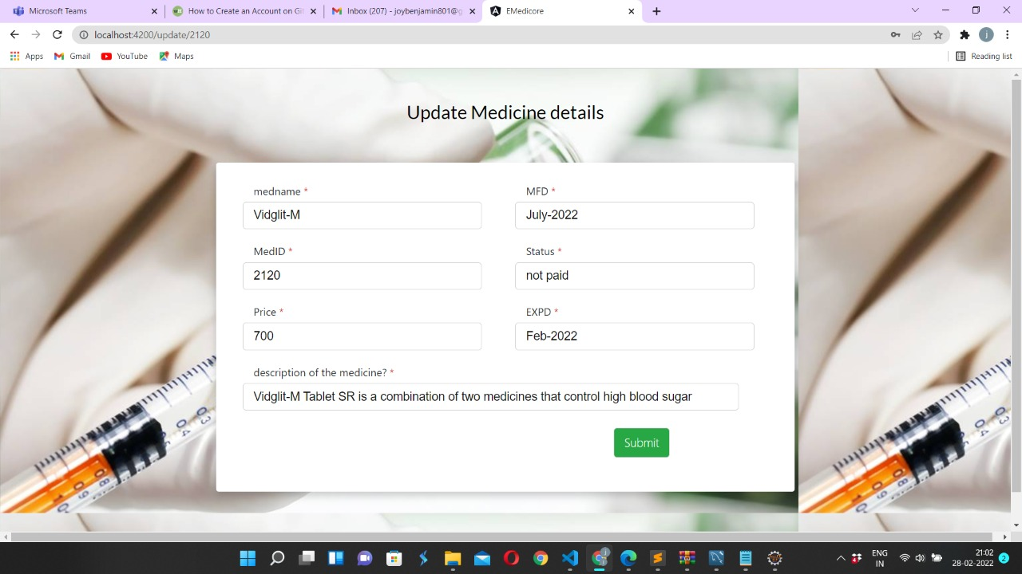
UPDATE MEDICINE DETAILS PAGE

Slide 22
CONCLUSION
Our project is only a humble venture to satisfy the needs to manage their project work. Several user-friendly coding has also adopted. The objective of software planning is to provide a frame work that enables the manger to make reasonable estimates made within a limited time frame at the beginning of the software project and should be updated regularly as the project progresses.
At the end it is concluded that we have made effort on following points
We understand the problem domain and produce a model of the system, which describes operations that can be performed on the system.
We included features and operations in detail, including screen layouts.
We designed user interface and security issues related to system.
Finally, the system is implemented and tested according to test cases.

Slide 23
THANK YOU

